Slide 1
Design a mobile-ordering app
for a burger sandwich restaurant to help users customize their burgers.
Nabil Ahmed

Slide 2
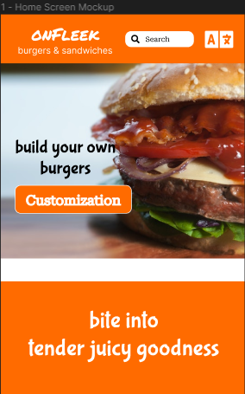
Project overview
The product:
My onFleek app helps users to customize their own burgers and sandwiches.
Preview of selected polished designs.
Project duration:
October 2022 to March 2023

Slide 3
Project overview
The problem:
Working professionals find it hard to customize and control the amount of ingredients in their burgers.
The goal:
My goal is to design an app that provides a best experience for working professionals so that they can customize their own burgers and sandwiches with ease.
I also want my customers to be able to control the amount of different ingredients in their burgers and sandwiches.

Slide 4
Project overview
Responsibilities:
My responsibilities are
Empathize with users
Crafting persona & user story
Defined needs with problem statement
Come up with solutions using crazy eights
Created lo-fi paper wireframe & prototype
Developed lo-fi digital wireframe & prototype
Conducted unmoderated usability study to test the design
Gathered feedback and improved design based on research insights
Designed hi-fi mockups & prototypes
Conducted second usability study to refined the final design
Last but not least participated in peer review feedback
My role:
UX Researcher, Interaction & Motion Designer

Slide 5
User research
Empathize with users
Personas & User Stories
Problem statements
User journey maps
Understanding
the user

Slide 6
User research: summary
I conducted user research to learn and understand how my onFleek burger and sandwiches app helps users to customize their own burgers and sandwiches with ease.
For this purpose I conducted an unmoderated usability study with five Toronto based working professionals. Each session lasted for about 30 minutes.
All the participants found the app quite easy to use and most participants wanted an quick & easy way to start customizing their burgers. I updated my hi fi design based on that research insights.

Slide 7
User research: pain points
1
2
3
Customize Button
Check out
Favorite Button
For most users
it was not clear how to
start customizing their
burgers from home screen
For most participants
checking out their
burgers was not quick & easy. There should be a check out button beside preview
Participants wanted to have a “save customization details” as their favorite burgers to avoid adding details each time they buy the same burger

Slide 8
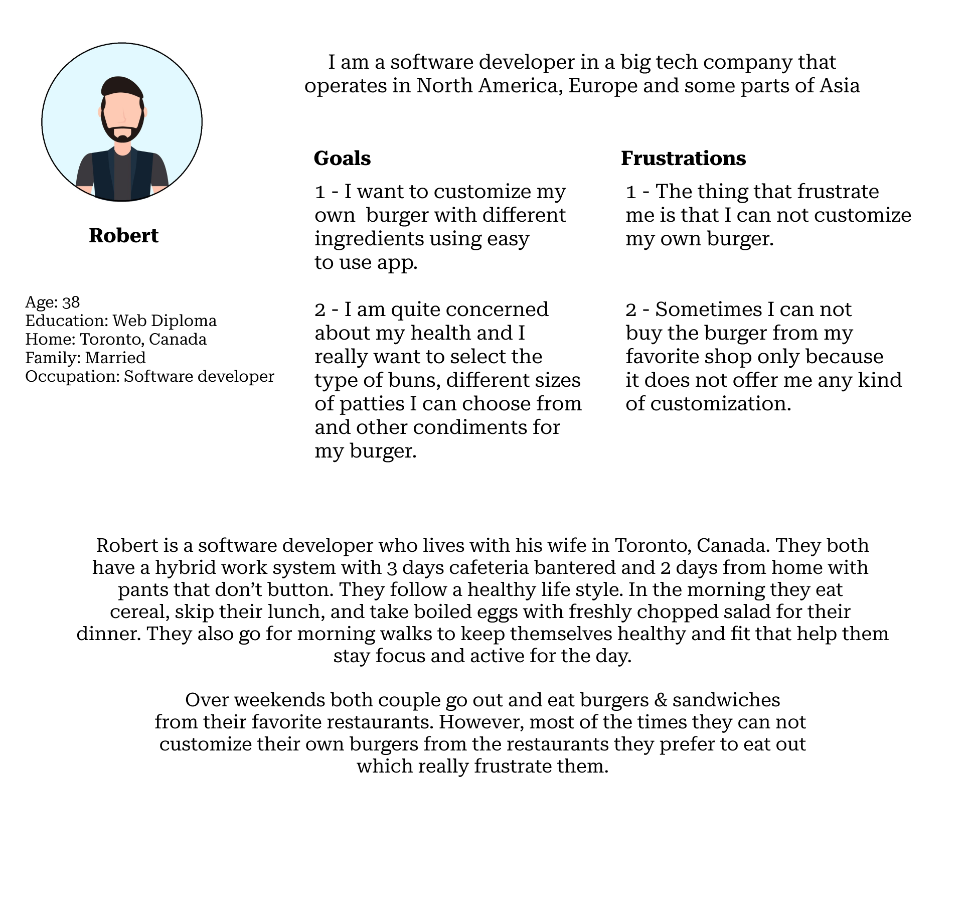
Persona: Robert
Problem statement:
Robert is a software developer
who needs to customize his own burger with multiple types of buns, different sizes of patty, and other condiments using app
because the restaurant he likes to eat the burger from, does not offer any customization option.

Slide 9
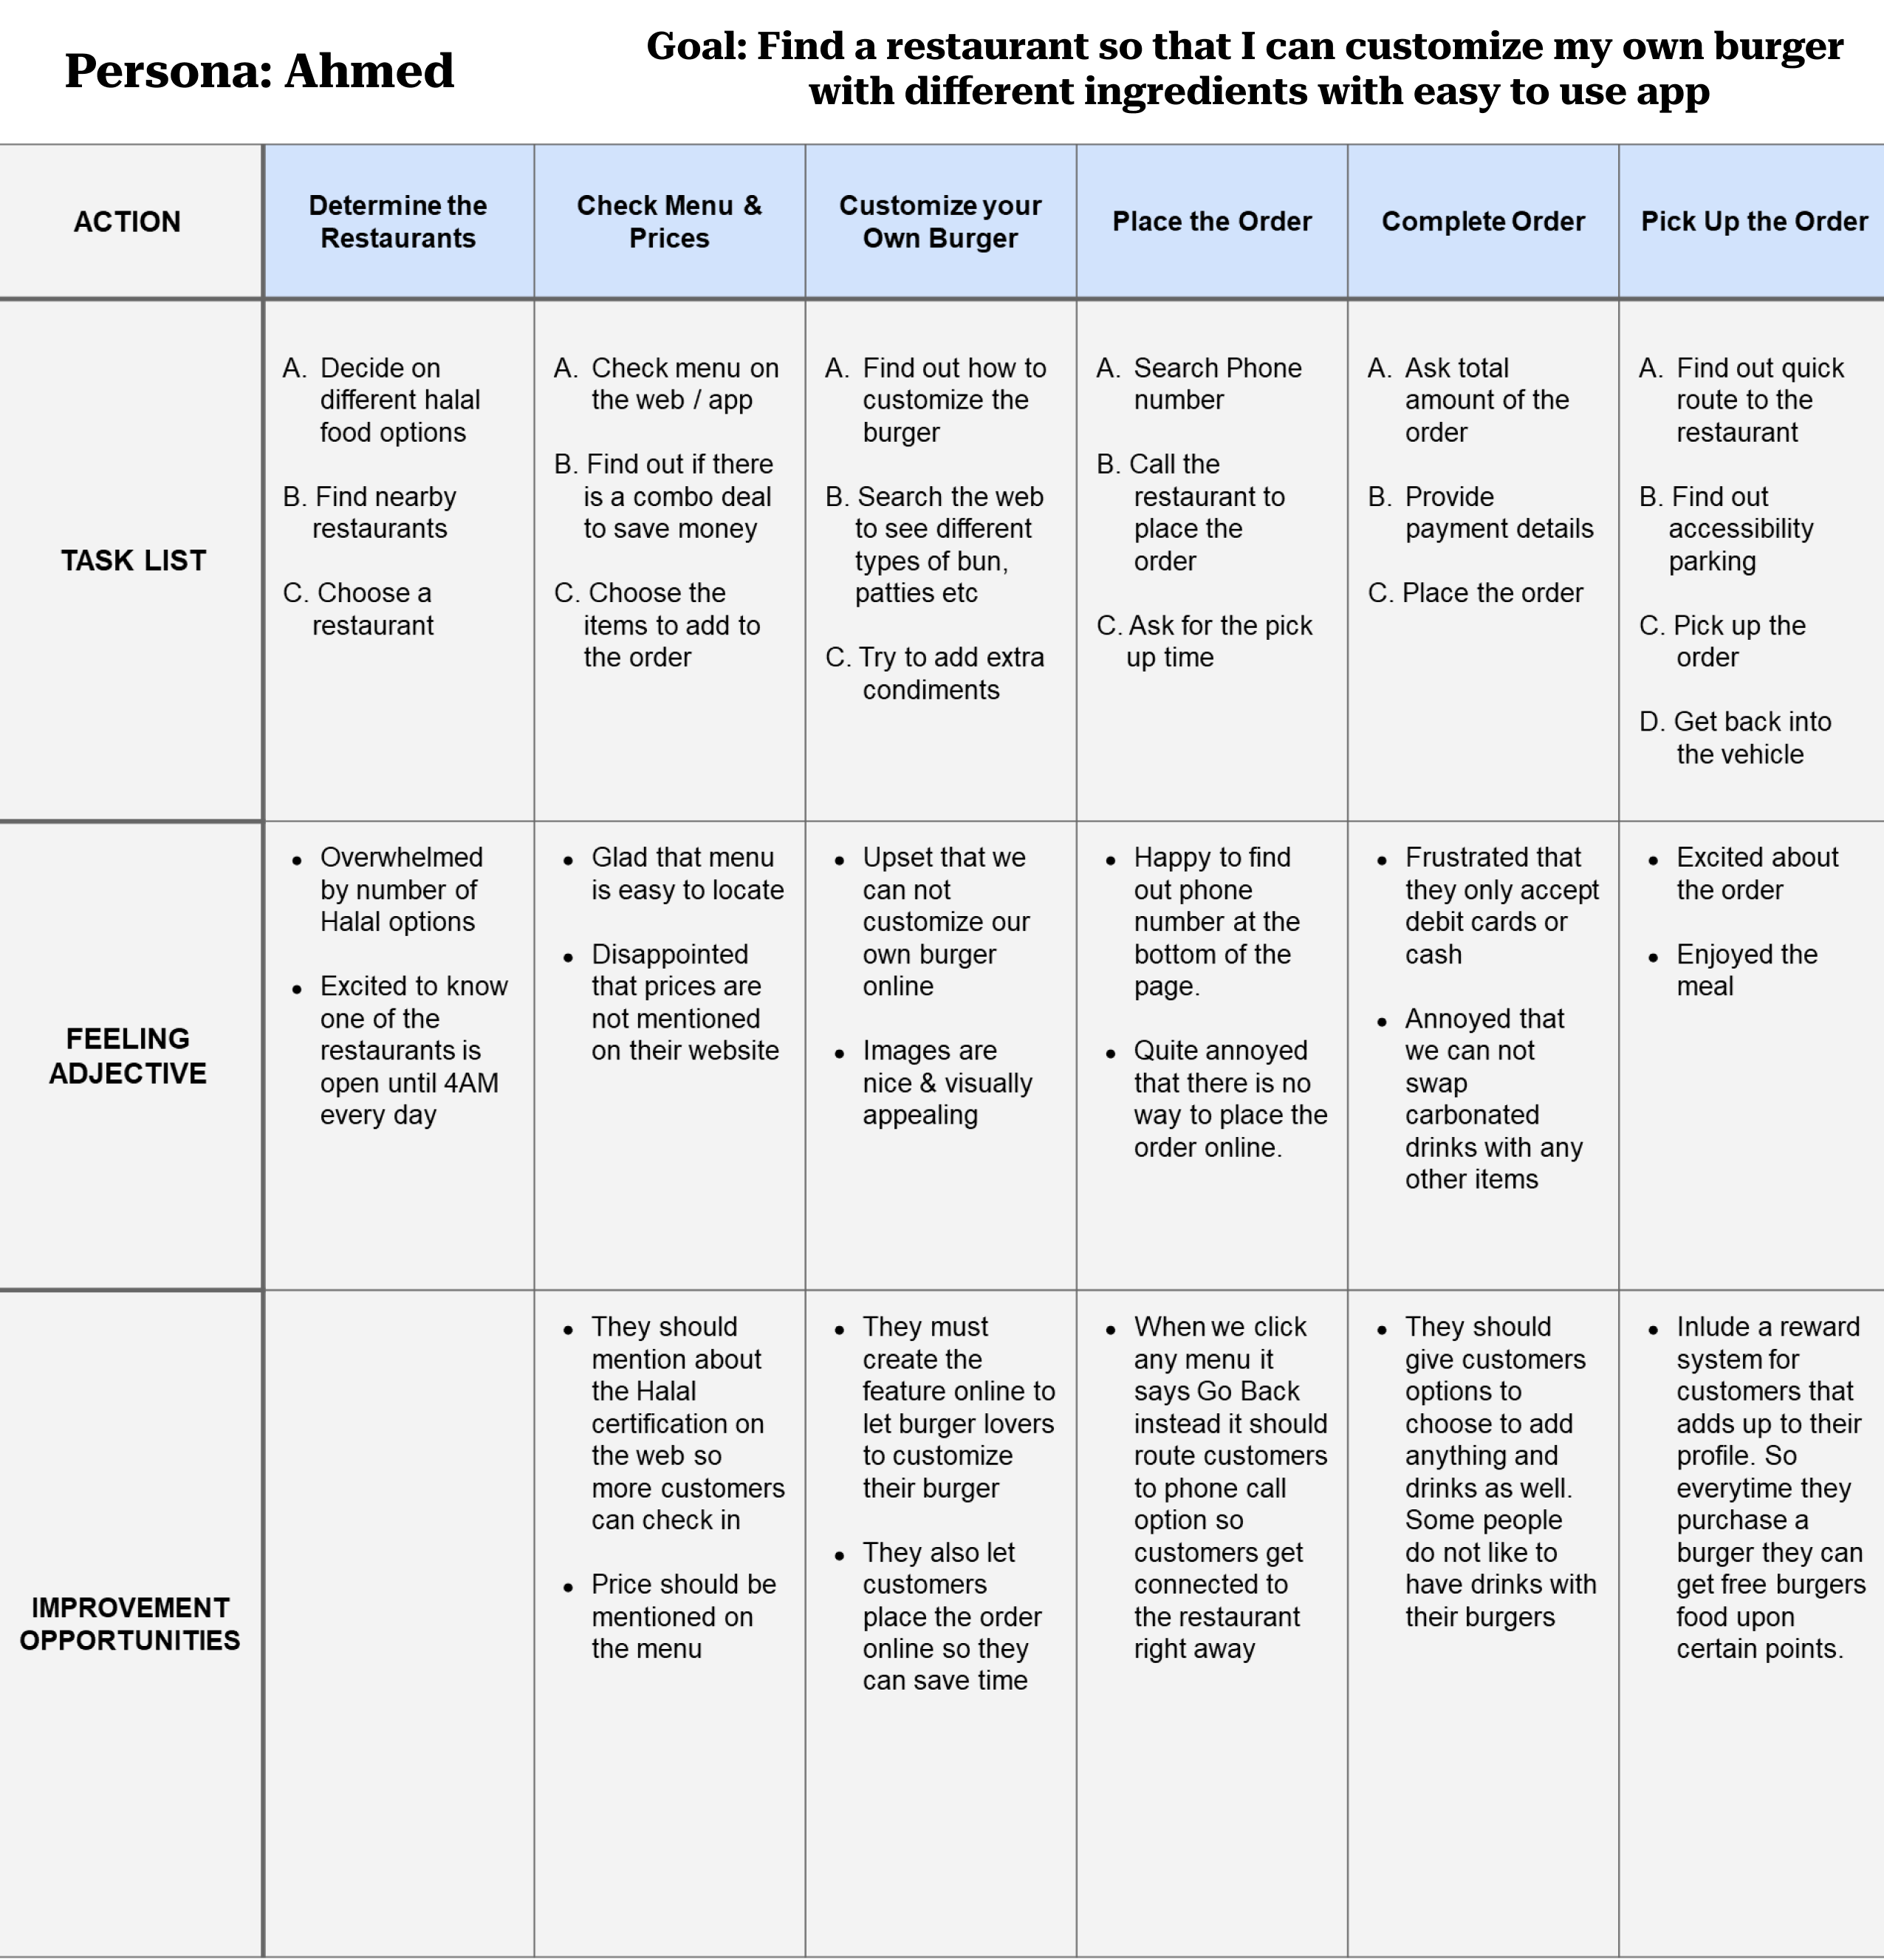
User journey map
A journey map revealed for another customers who could not find the restaurant that he could customize his own burger from.
This journey helped the customer.
Image of user journey map

Slide 10
Paper wireframes
Digital wireframes
Low-fidelity prototype
Usability studies
Starting
the design

Slide 11
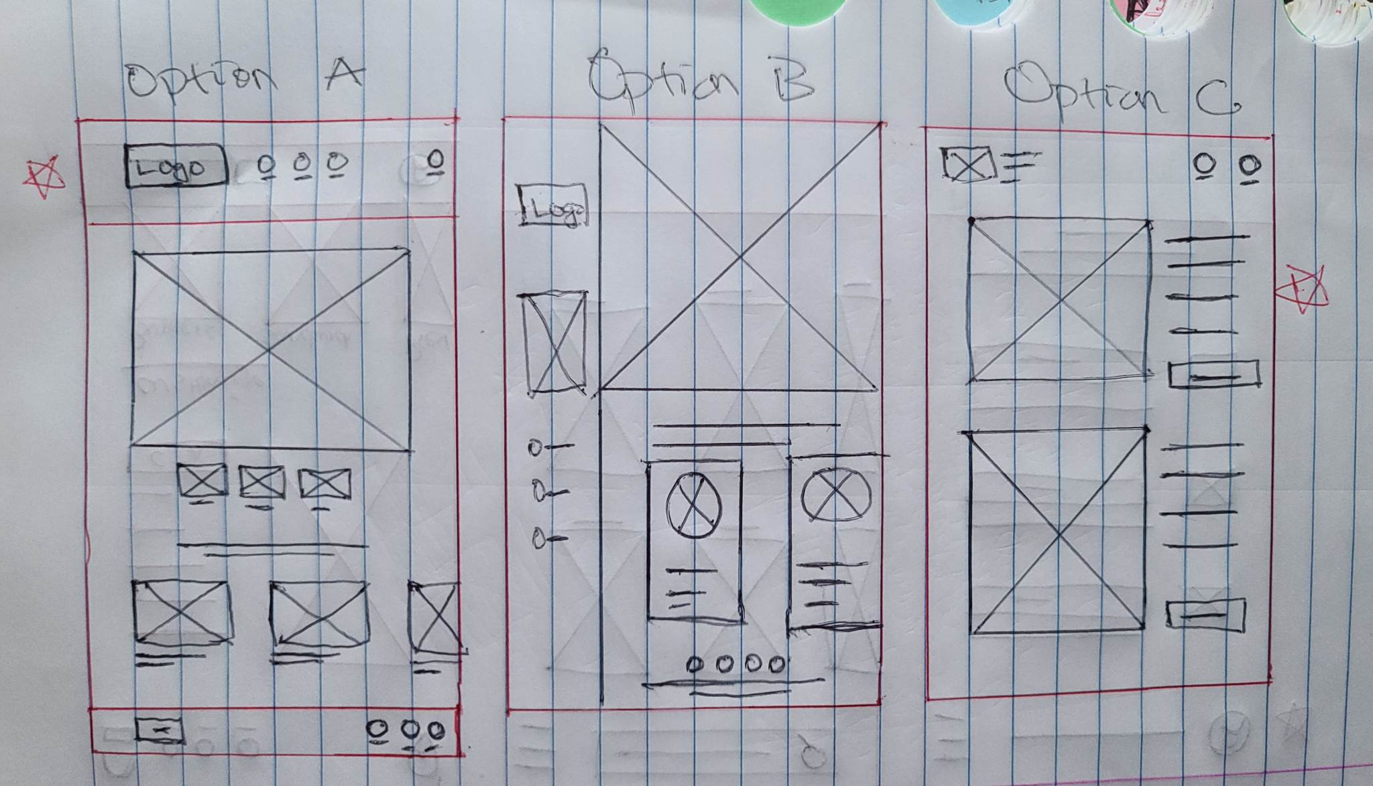
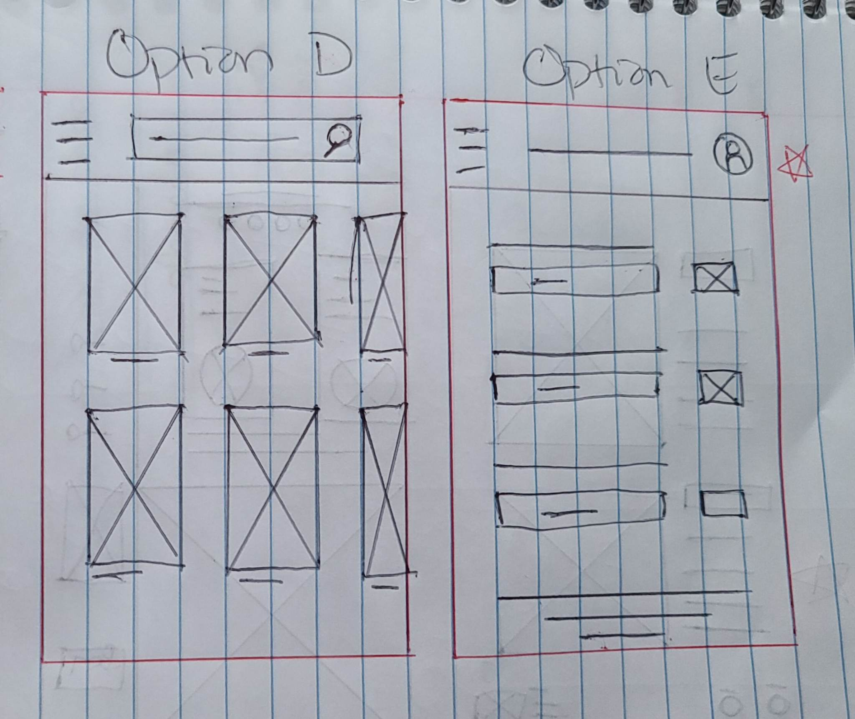
Paper wireframes
Since my goal is to design an app that provides a best experience for working professionals to customize their own burgers.
I came up with 5 different versions of the same screen. All of them have 1 thing in common a highlighted customize button front and center.
Image of paper wireframes including five different versions of the same screen and one image of the new, refined version

Slide 12
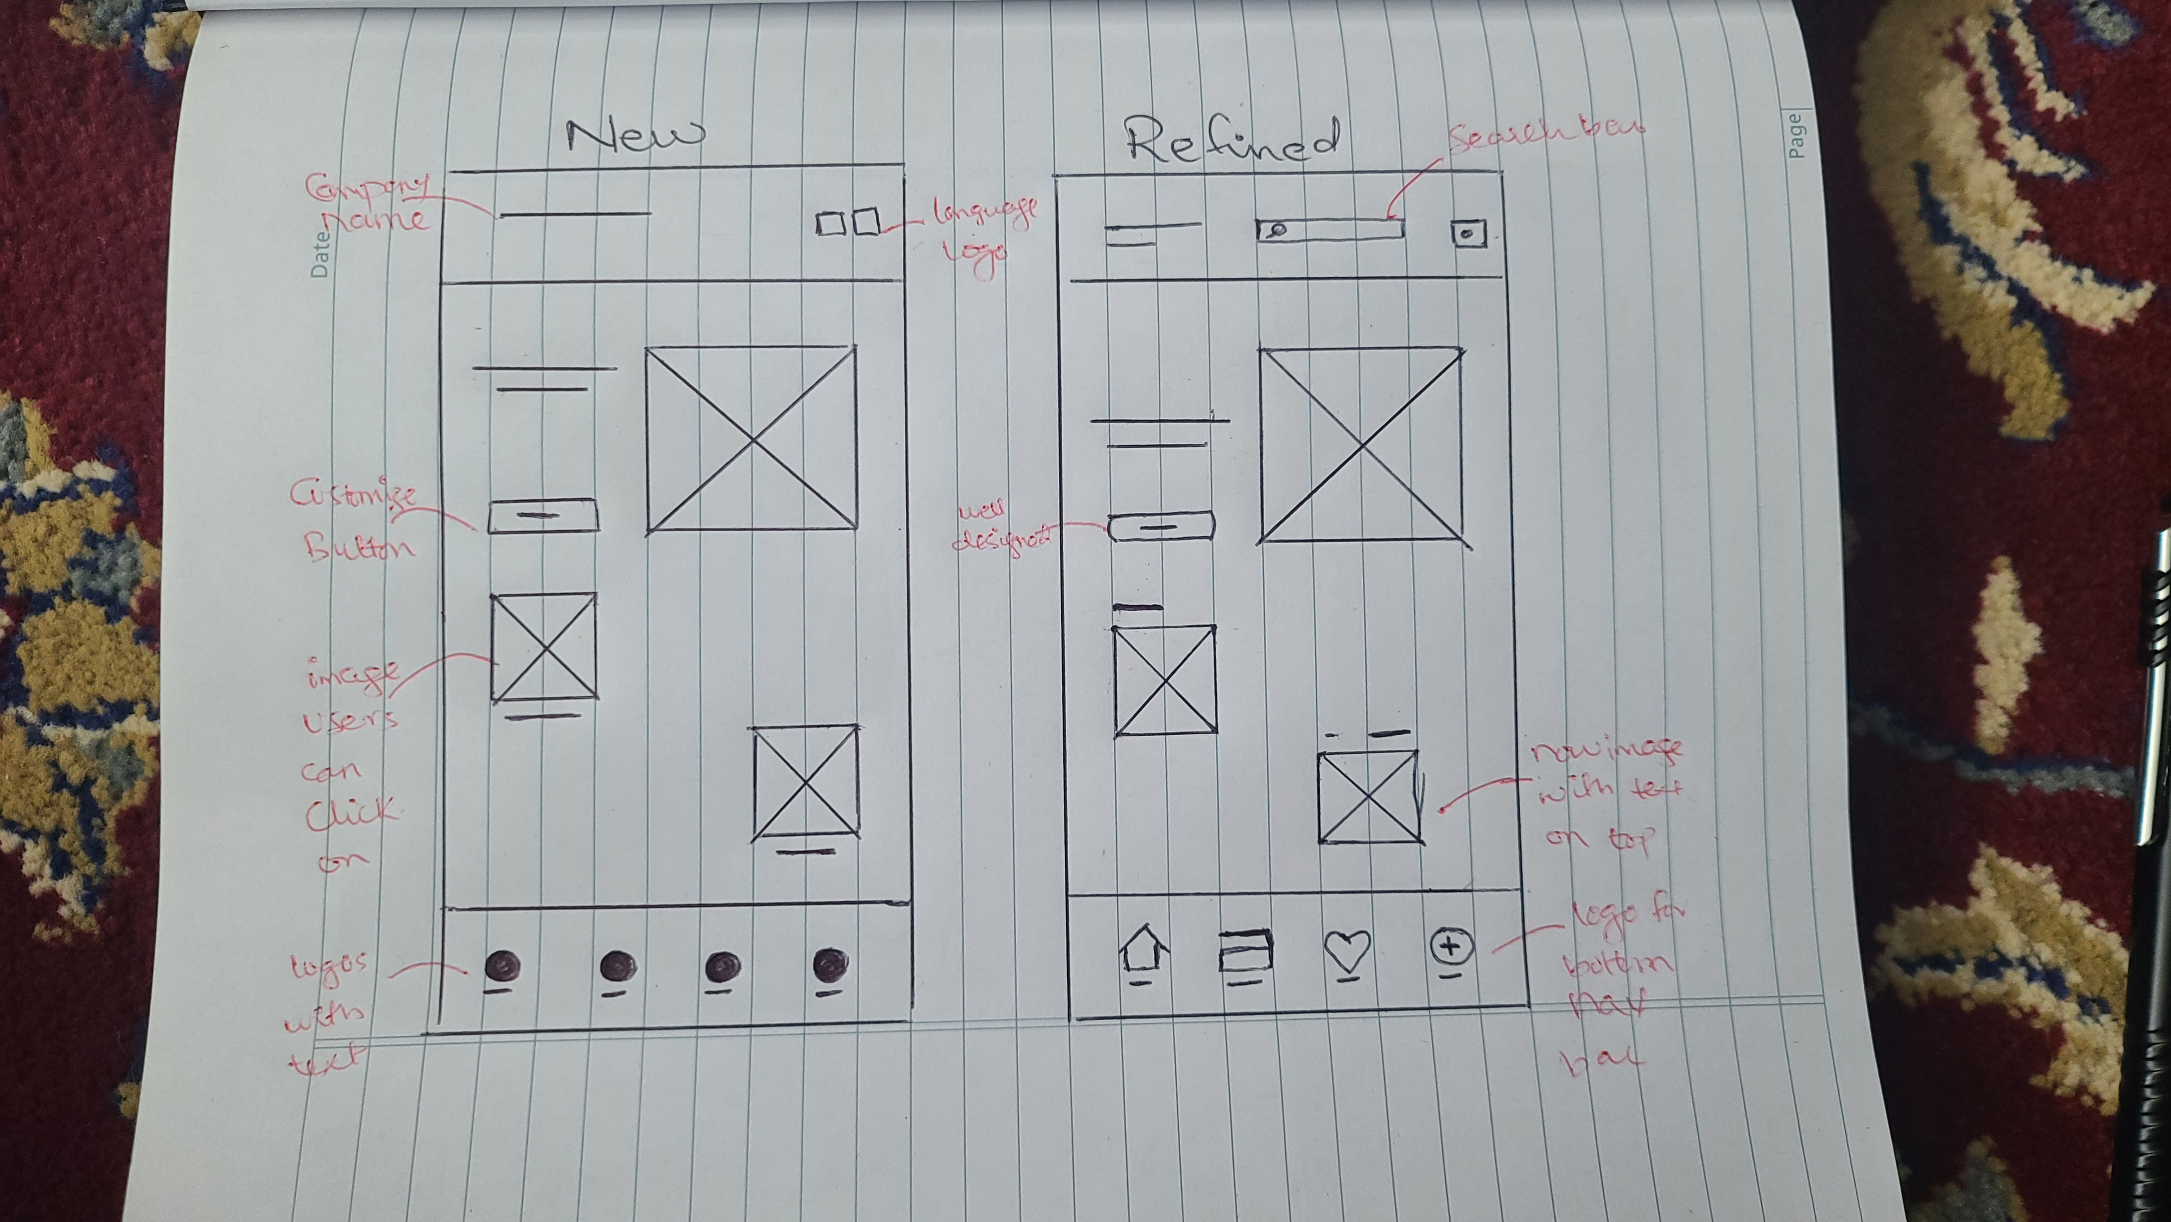
Paper wireframes
continue
This is new and refined version of my paper wireframe.
I have annotated them as well to show how a user will be able to customize their burgers and sandwiches easily.
Image of paper wireframes including five different versions of the same screen and one image of the new, refined version

Slide 13
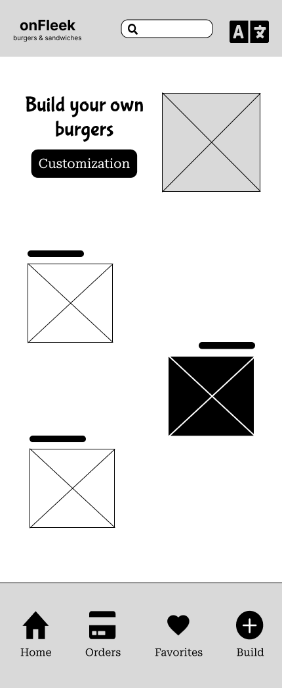
Digital wireframes
A customize button is provided front and center so that users can customize their burgers easily.
A glimpse of a digital wireframe created on figma. It provides an easy way for users to start customizing their burgers right off the home screen.
Insert first wireframe example that demonstrates design thinking aligned with user research
Customers can also click one of these images to either customize a burger or a sandwich.

Slide 14
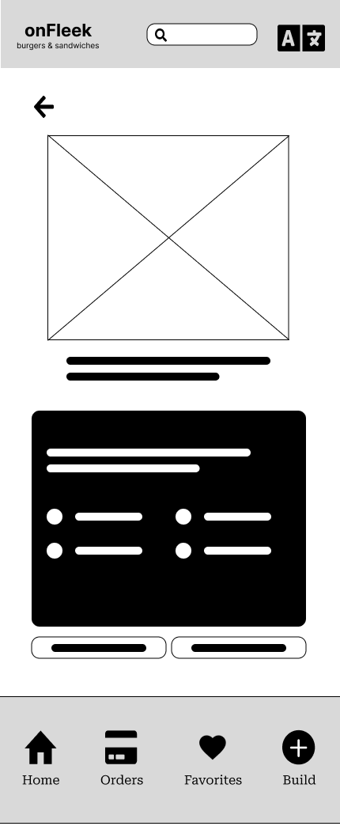
Digital wireframes
A back arrow is provided for users in case if they want to go back to previous screen to make any adjustments.
Another screen of digital wireframe that provide customers with different options to customize their burgers and sandwiches.
Insert second wireframe example that demonstrates design thinking aligned with user research
Couple of boxes like these are provided for customers where they can select different types of buns, patty sizes, and other condiments
Two CTA buttons also provided at the end so that customers can easily check out or preview what they have built.

Slide 15
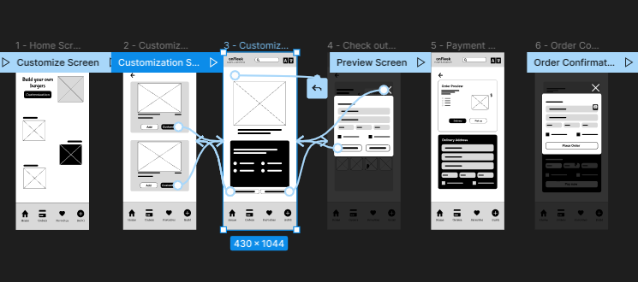
Low-fidelity prototype
With the help of digital wireframe, I was able to create a prototype that showed interaction with the app
https://www.figma.com/proto/DsVuCwnpZsQxyzwFWsBRTH/Google-UX-Design---Burger-Customization-Wireframe?node-id=242%3A11&scaling=contain&page-id=242%3A9&starting-point-node-id=242%3A11&show-proto-sidebar=1
Screenshot of prototype with connections or prototype GIF

Slide 16
Usability study: findings
I conducted two unmoderated usability studies to learn & understand how this burger customization app helps users to customize their own burgers and sandwiches with ease.
Round 1 findings
Round 2 findings
1
Users need quick and easy way to customize their burgers.
1
Userd need to start customizing right from the home screen.
2
Users need to add more items to their burgers easily.
2
Users need an easy and intuitive way to check out their burgers.
3
Users want to checkout their burgers easily.
3
Users need to save their customization details to avoid adding them each time they buy a same burger.

Slide 17
Refining
the design
Mockups
High-fidelity prototype
Accessibility

Slide 18
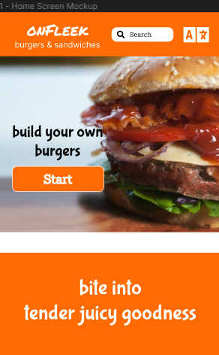
After usability study
Before usability study
Mockups
I added typography, colors, and icons to create a mock up.
Two different versions of mockups are presented as before and after usability studies. Customers wanted to have a customization button on the home screen.
Image of selected screen before usability study
Image of selected screen after usability study

Slide 19
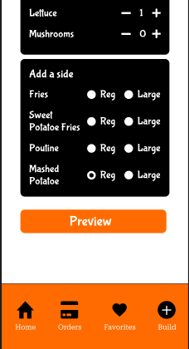
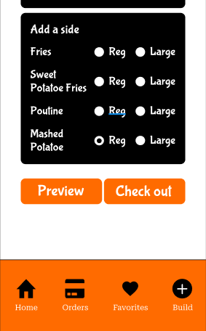
Mockups
Before usability study
After usability study
I also provided Checkout CTA button based on the research insight that I received from most customers where they wanted to check out their burgers easily.
Image of selected screen before usability study
Image of selected screen after usability study

Slide 20
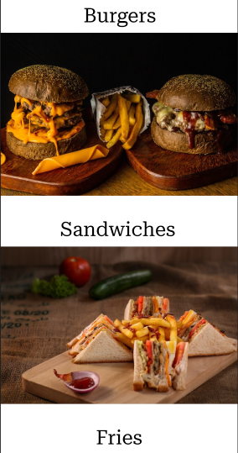
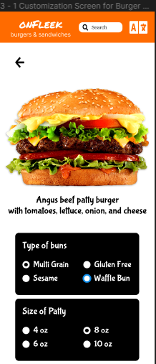
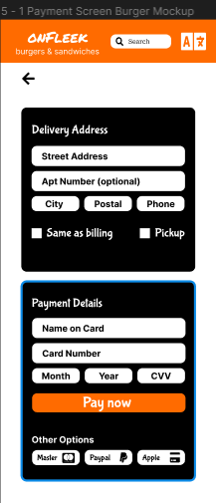
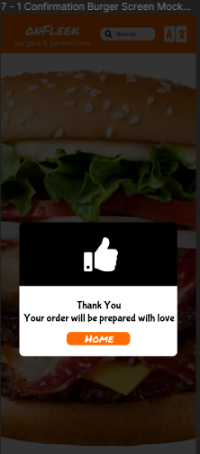
Mockups
Main mockup screen for display
Main mockup screen for display
Main mockup screen for display
Main mockup screen for display

Slide 21
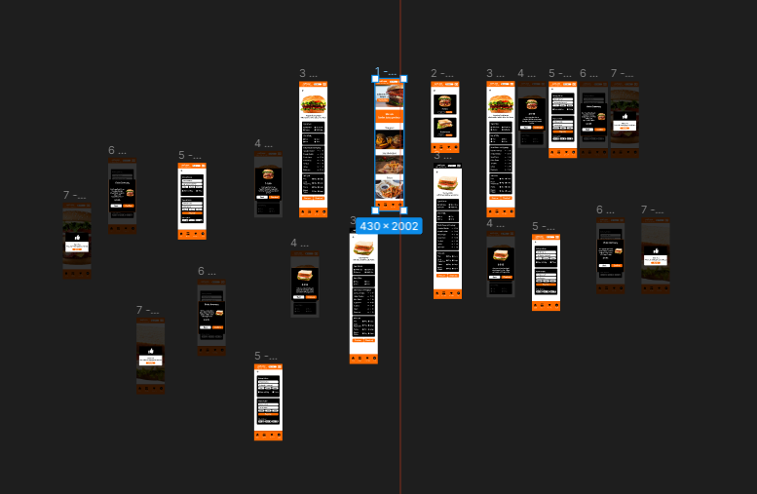
High-fidelity
prototype
This hi-fi prototype shows a complete design for burger customization.
https://www.figma.com/proto/DsVuCwnpZsQxyzwFWsBRTH/Google-UX-Design---Burger-Customization-Wireframe?node-id=208%3A12&scaling=contain&page-id=208%3A10&starting-point-node-id=208%3A12&show-proto-sidebar=1
Screenshot of prototype with connections or prototype GIF

Slide 22
Accessibility considerations
1
2
3
I have provided a language icon right at the top navigation bar. It will help users with different languages.
I have also used highest possible contrast colors with black as primary, white as secondary, and orange as accent colors to provide best user experience.
Alt text also added to all the images that will help users with screen readers.

Slide 23
Going forward
Takeaways
Next steps

Slide 24
Takeaways
Impact:
This app will help users to customize their burgers and sandwiches with ease and fun.
My peers throughout the course were very supportive and they motivated me with their valuable feedbacks which are as follow,
Hi, nice job!
Keep up the great work.
Your design look very professional
What I learned:
I have got the opportunity to learn several things.
How to start and finish off tasks based on the needs of customers.
Empathizing with customers to learn their insights & new perspective about the design.
Collaborating with other designers by effectively receiving and providing feedback on each others assignments.

Slide 25
Next steps
1
2
3
I would like to try to make a smooth animation when pages transition to new page. It is a bit jaring at the moment.
I would also like to add another screen for customization details as favorite.
I will keep looking to see if there is any way I can make the content concise with less words.

Slide 26
Insert a few sentences summarizing the next steps you would take with this project and why. Feel free to organize next steps in a bullet point list.
Let’s connect!
I am Nabil and I am on my way to become an Interaction & Motion UX designer.
Thank you for taking out time to check my design journey. If you’d like to get in touch, my contact information is provided as below
Email: nabilgj.bnm@gmail.com
Website: www.nabilaio.com

Slide 27
Thank you!

